Slide 1
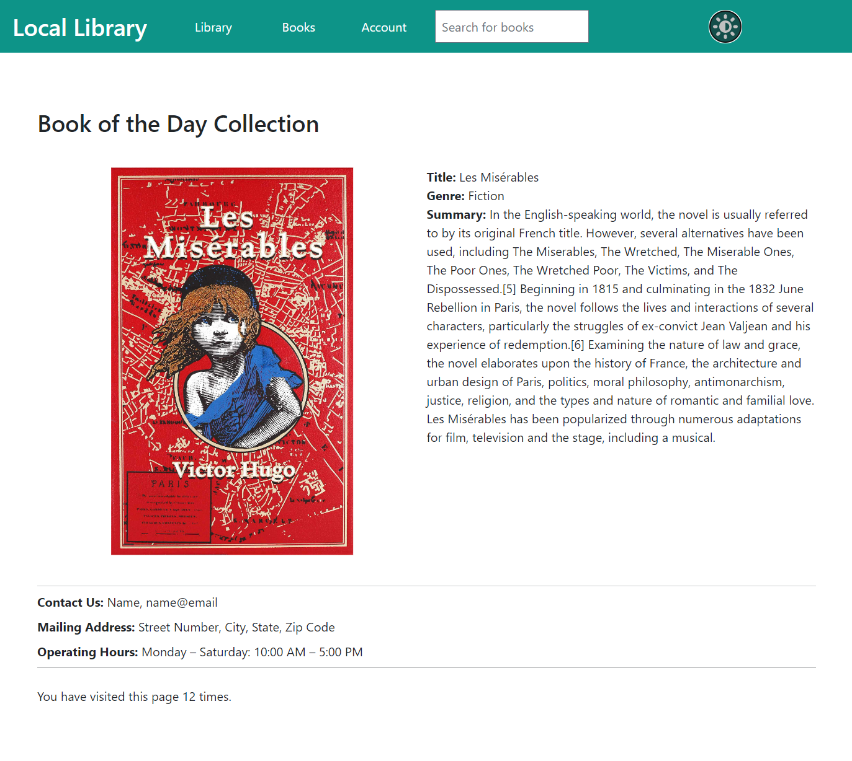
LIBRARY WEBSITE
TEAM 12
CEN 4010 (RVD)
FALL 2022

Slide 2

Account Creation
Regardless of the type of account, account creation can be done in one of two ways: via the admin page or via the library website.

Slide 3
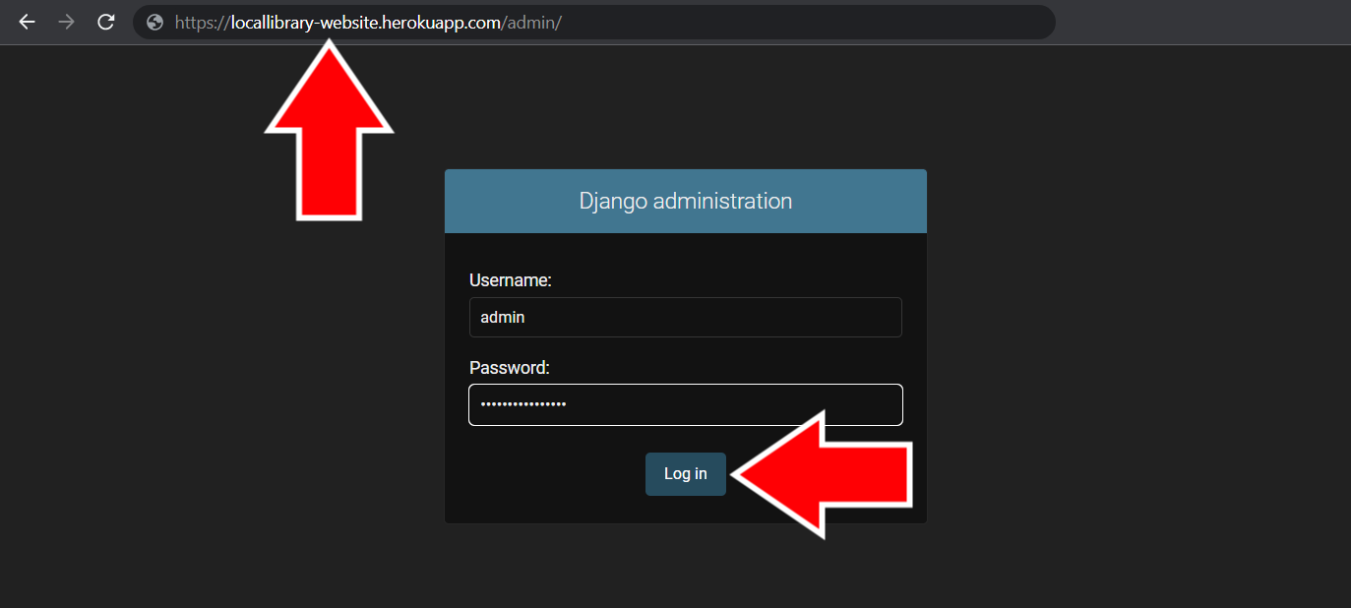
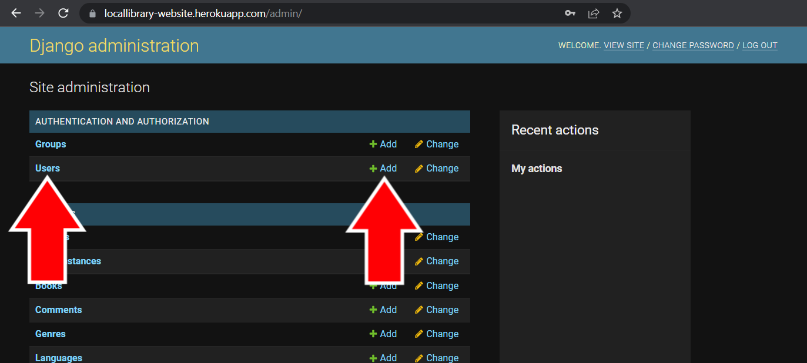
Account Creation via the Admin Page
Administrative or Staff accounts can create new user accounts from the admin page of the website. These are the steps to create an account on the admin page.

Slide 4
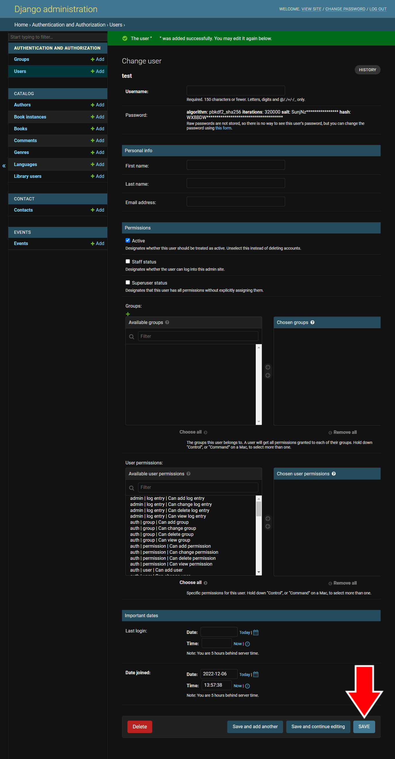
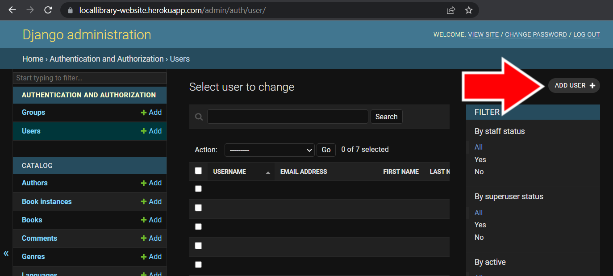
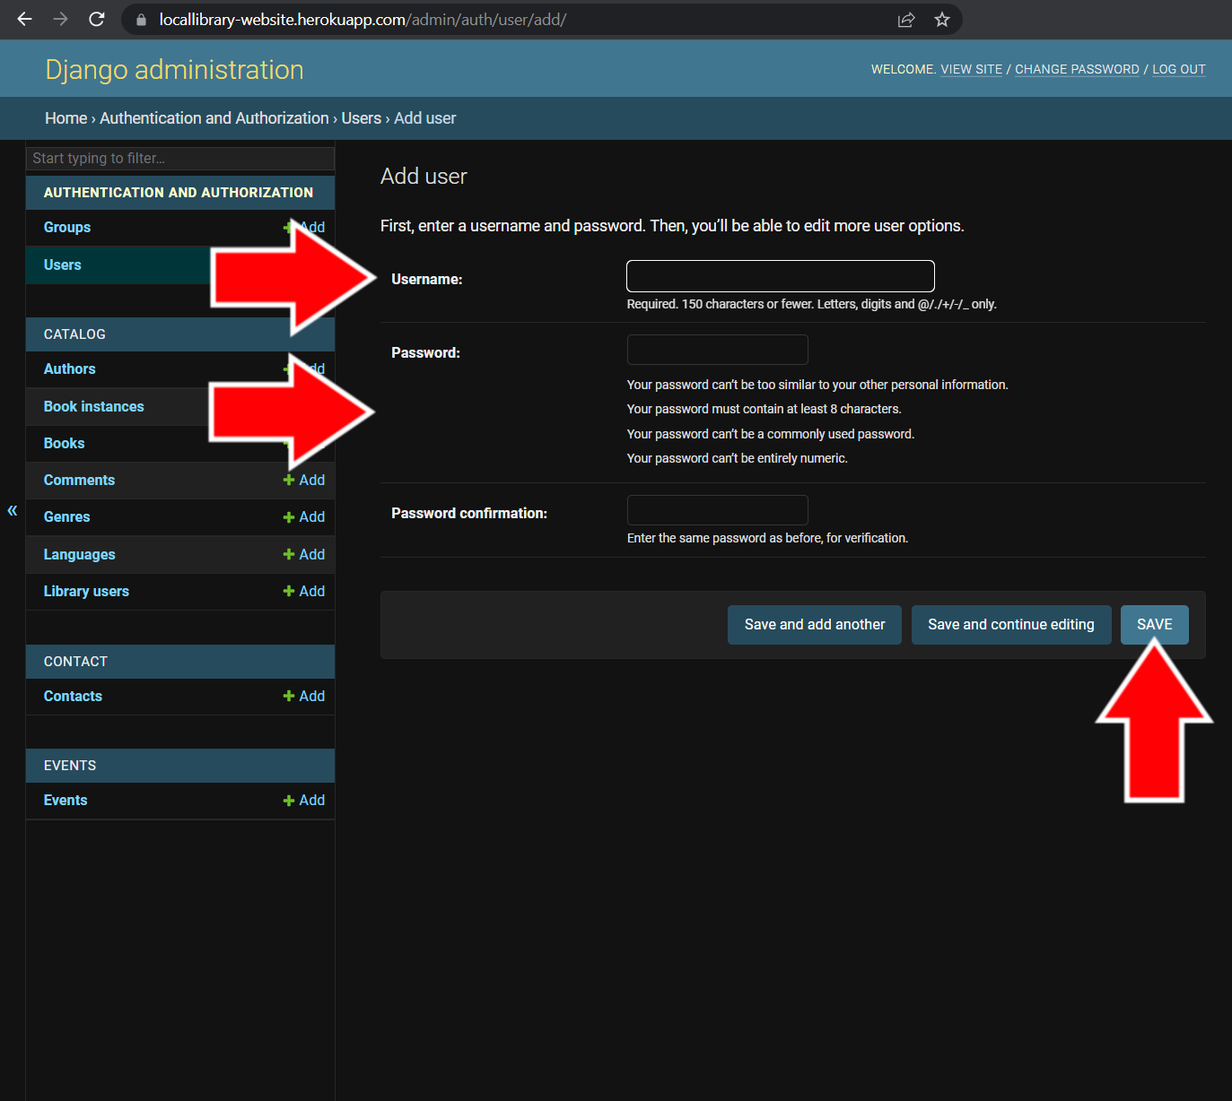

Slide 5
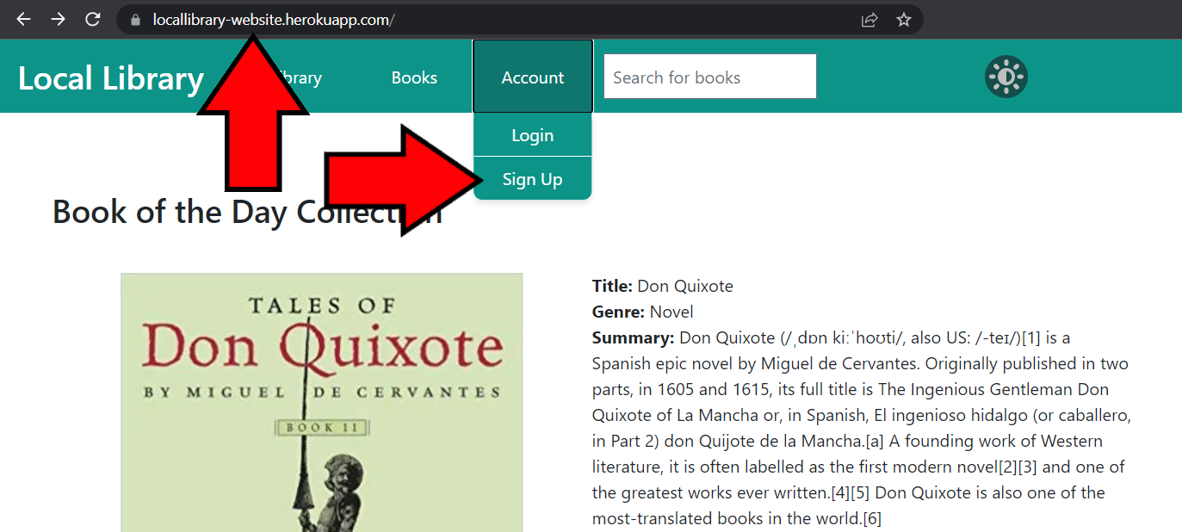
ACCOUNT creation VIA THE LIBRARY WEBSITE
Anyone can initiate the creation of an account via the Library Website. Here are the steps to create an account on the Library Website.

Slide 6
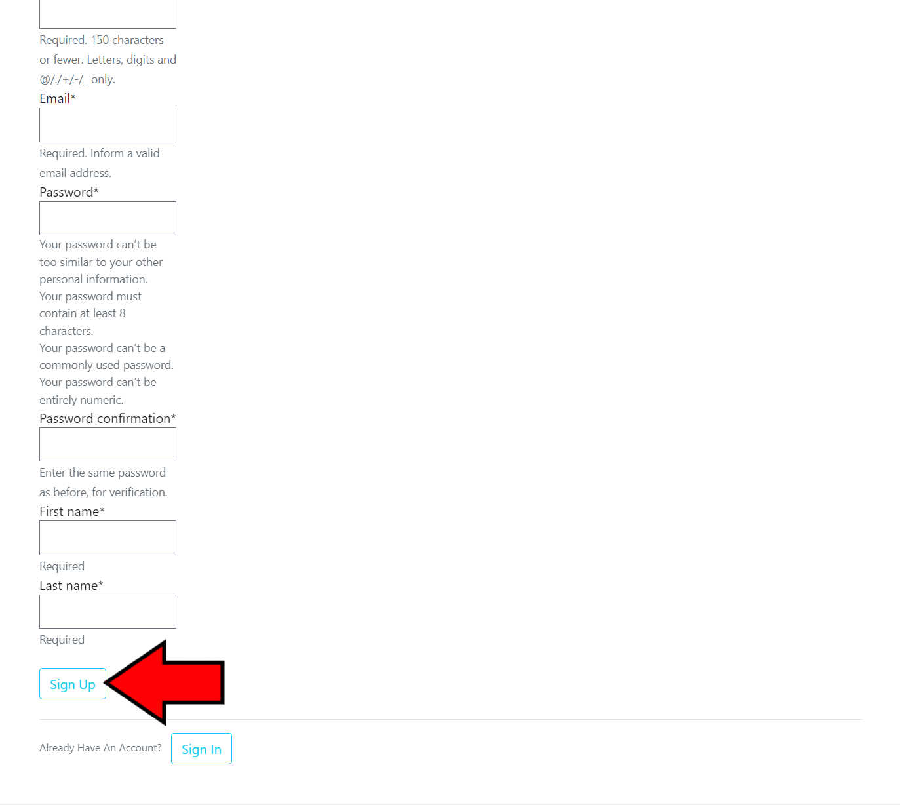

Slide 7
Editing an Account
Once a user account has been created, the information and permissions on the account can be changed by an administrative or staff account on the admin page. Here are the steps the change a user account’s information.

Slide 8
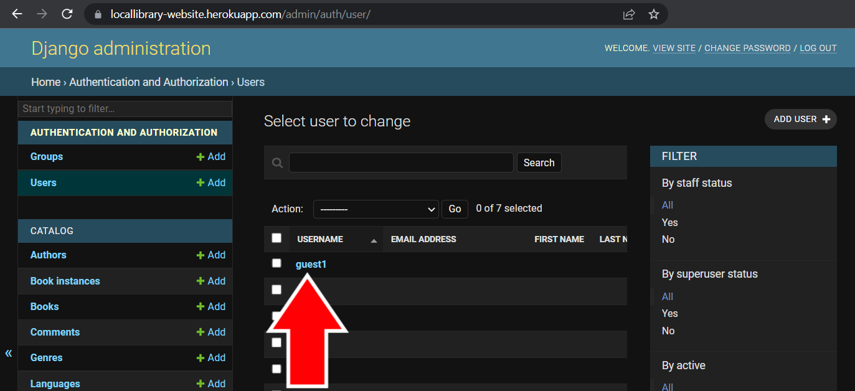

Slide 9

Permissions
The permissions on user accounts are the allowed features that account can interact with. It is important to make sure each account has the correct permissions.

Slide 10
Permission Types
Admin, Auth, Content Types, Sessions – These permissions are for administrative purposes and should only be given to high level staff or account users (such as IT staff or those who are responsible for maintaining the website).
Catalog – These permissions are for changing the catalog and library user permissions.
Library User – The library user subcategory is given to accounts who are allowed to borrow books from the library.
Other Subcategories – All of the other catalog subcategories are for changing book information (books, copies, authors, genres, languages, and comments).
Contact – These permissions are for interacting with the messages received from the Contact Page form.
Events – These permissions are for changing event details on the Calendar Page.

Slide 11
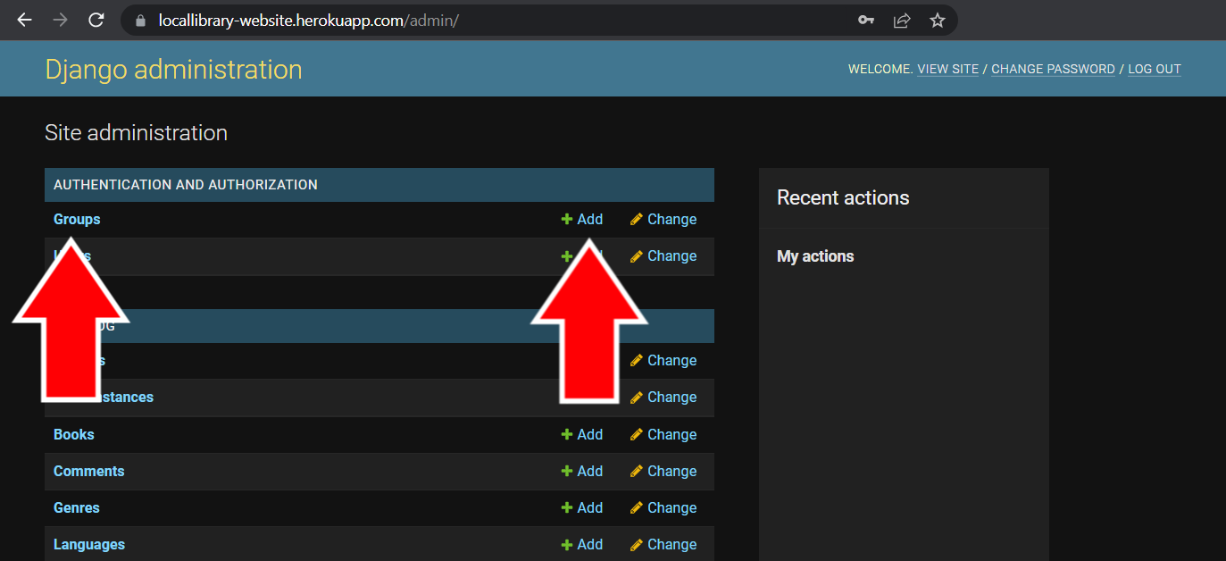
Creating Group Permissions
Group permissions make it easy to keep track of which account has which permissions by grouping the permissions based on what kind of access certain types of user accounts get. Here are the steps to creating a group.

Slide 12
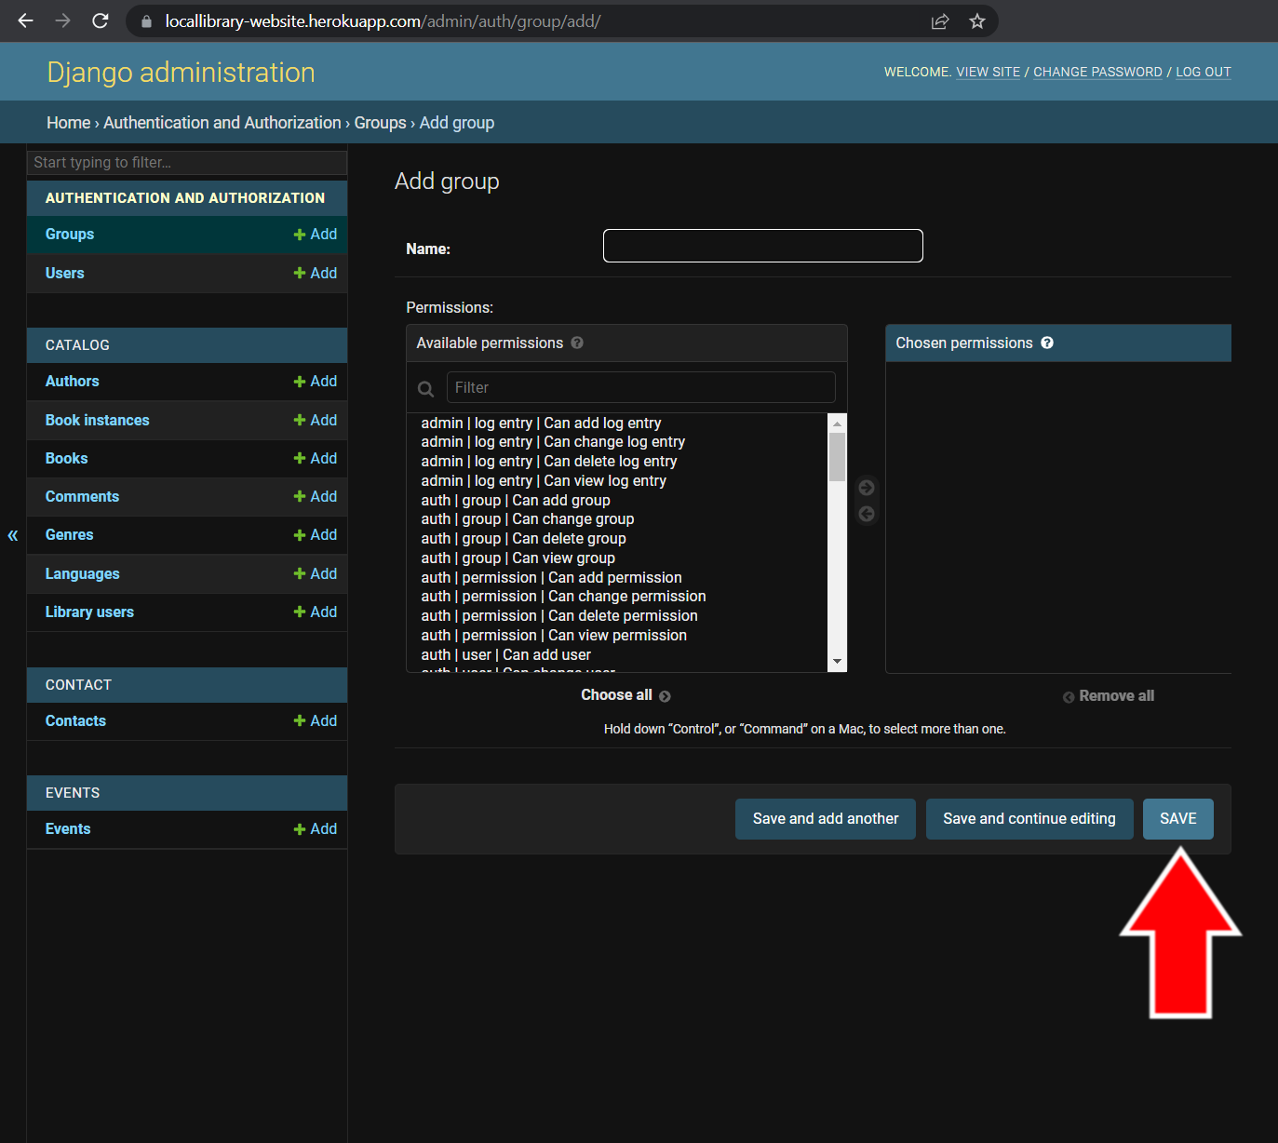
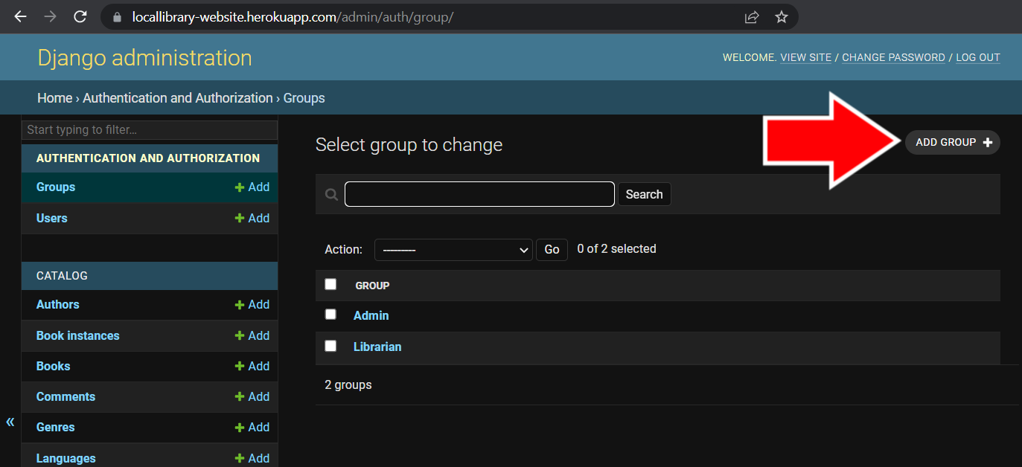

Slide 13


Catalog
Categories
The catalog is the section of the library website that holds all the information for the books and calendar. It has several interactive features, discussed in the following.

Slide 14
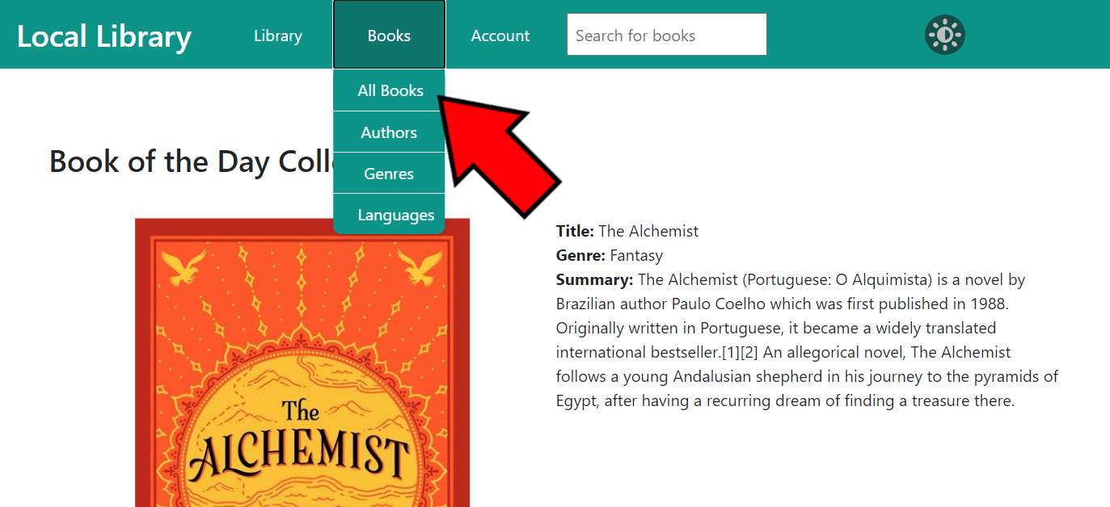
Books
The books in the catalog are separated into several categories. Library users can view books according to each category.

Slide 15
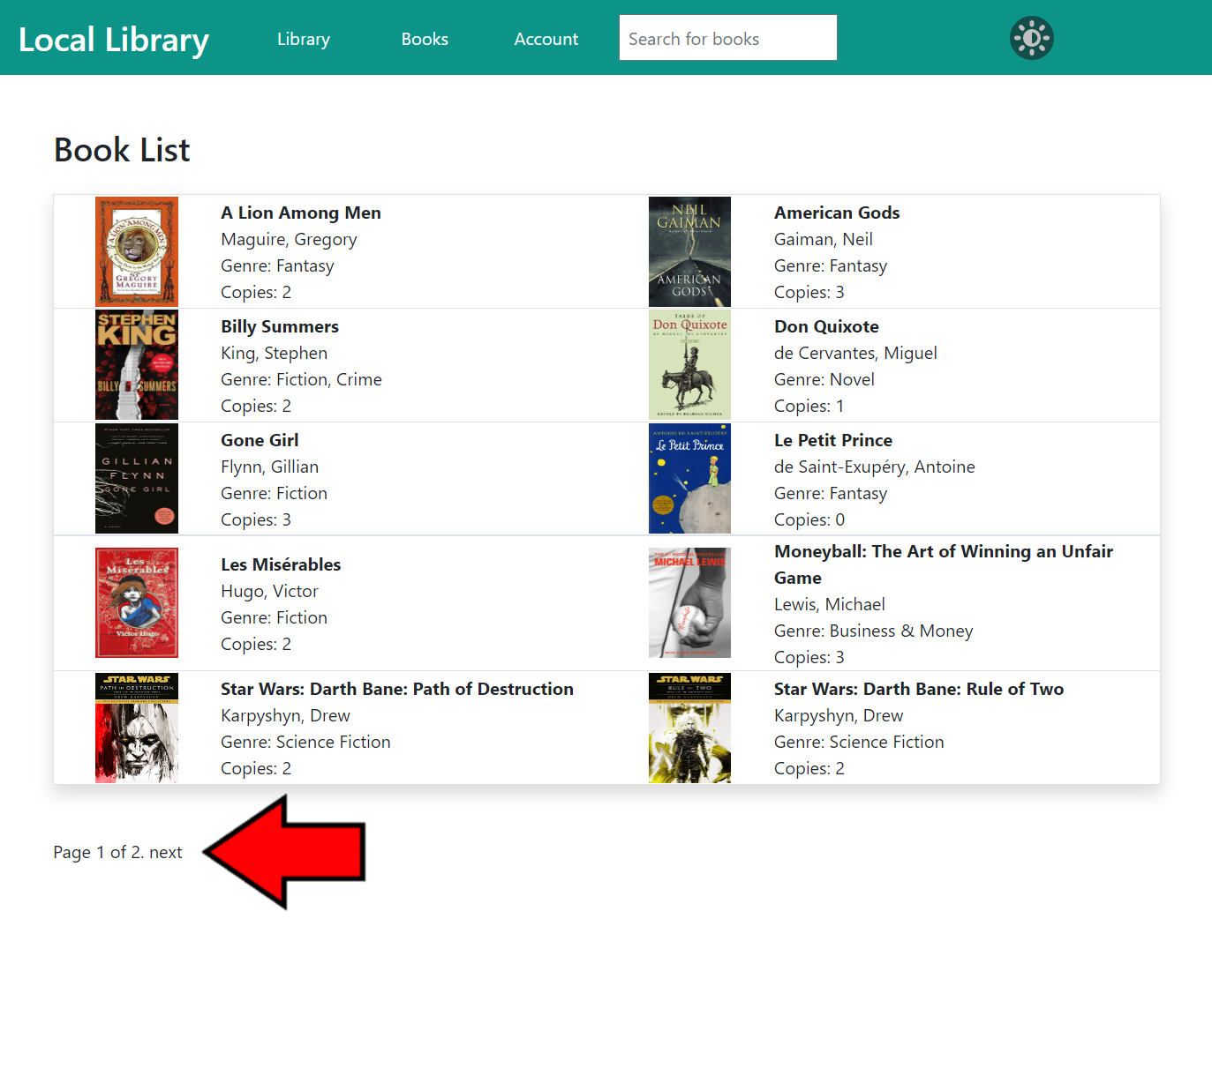

Slide 16
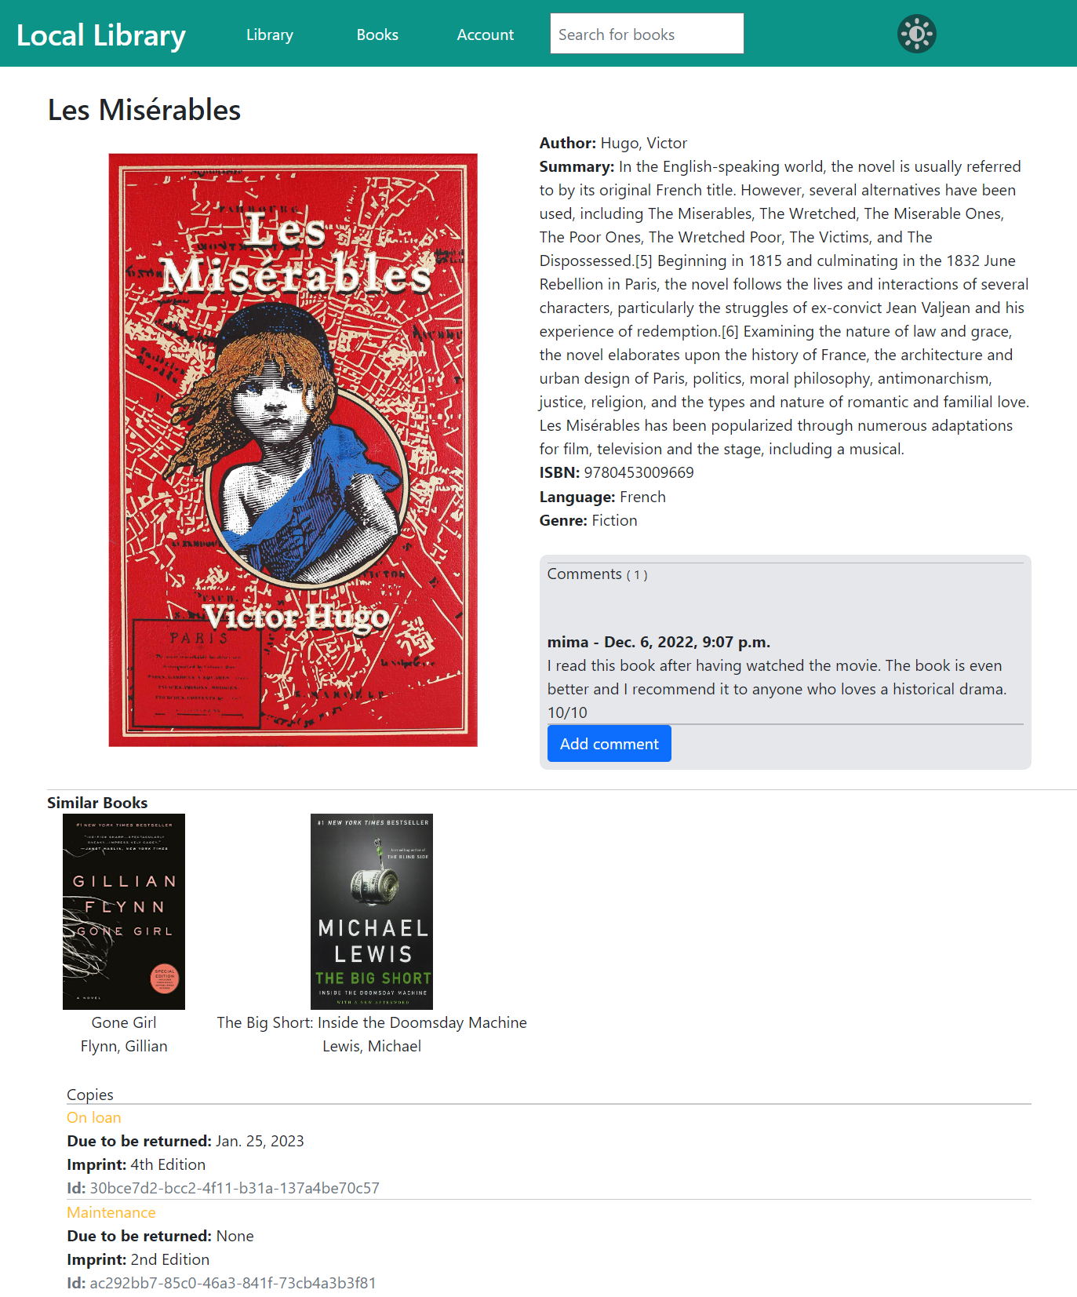

Slide 17
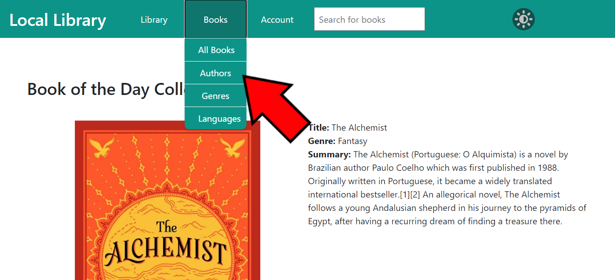
Authors
Authors in the catalog are separated into several categories. Library users can view authors according to each category.

Slide 18
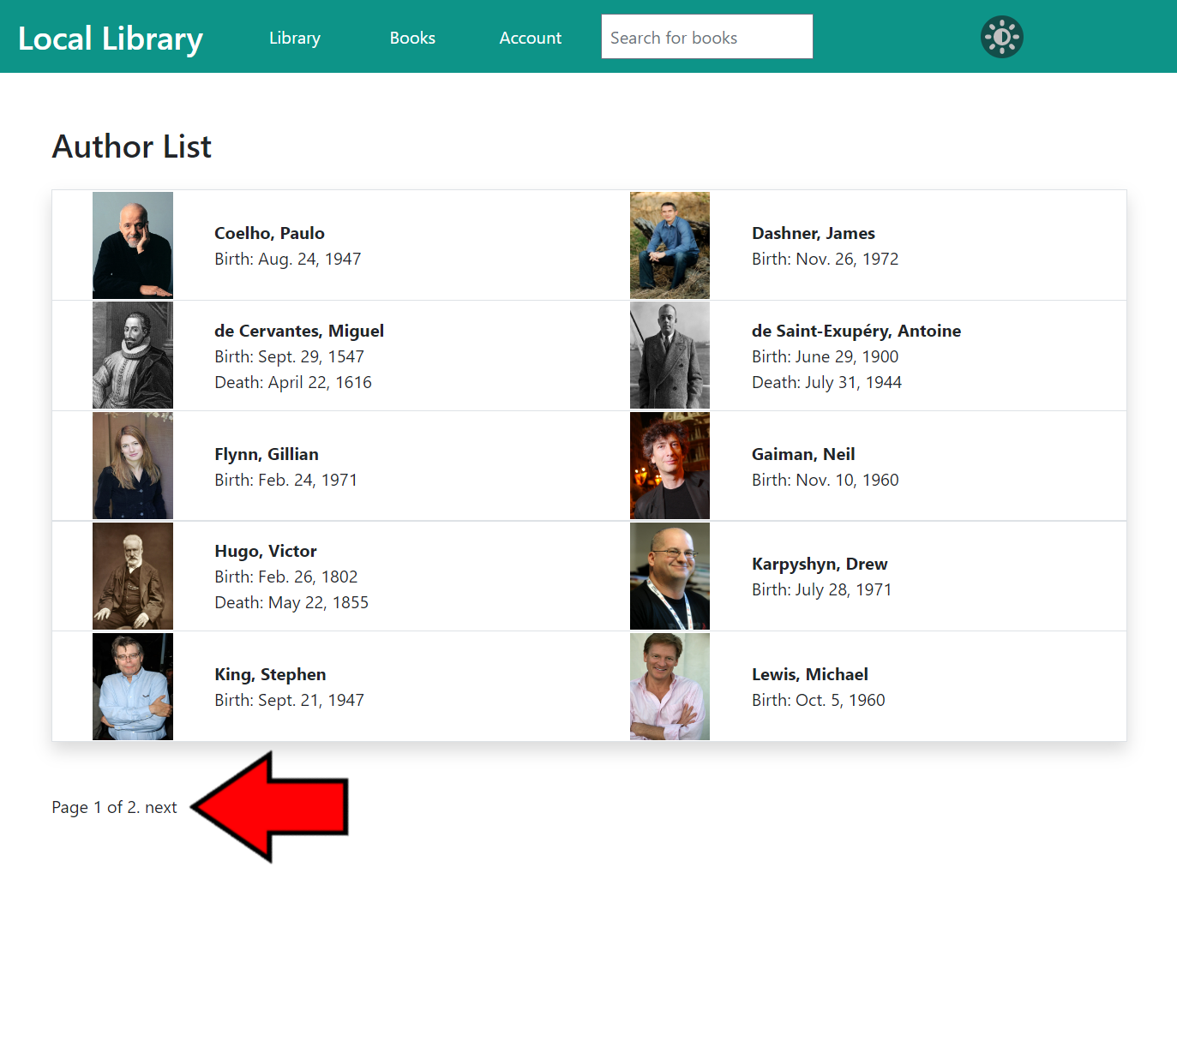

Slide 19
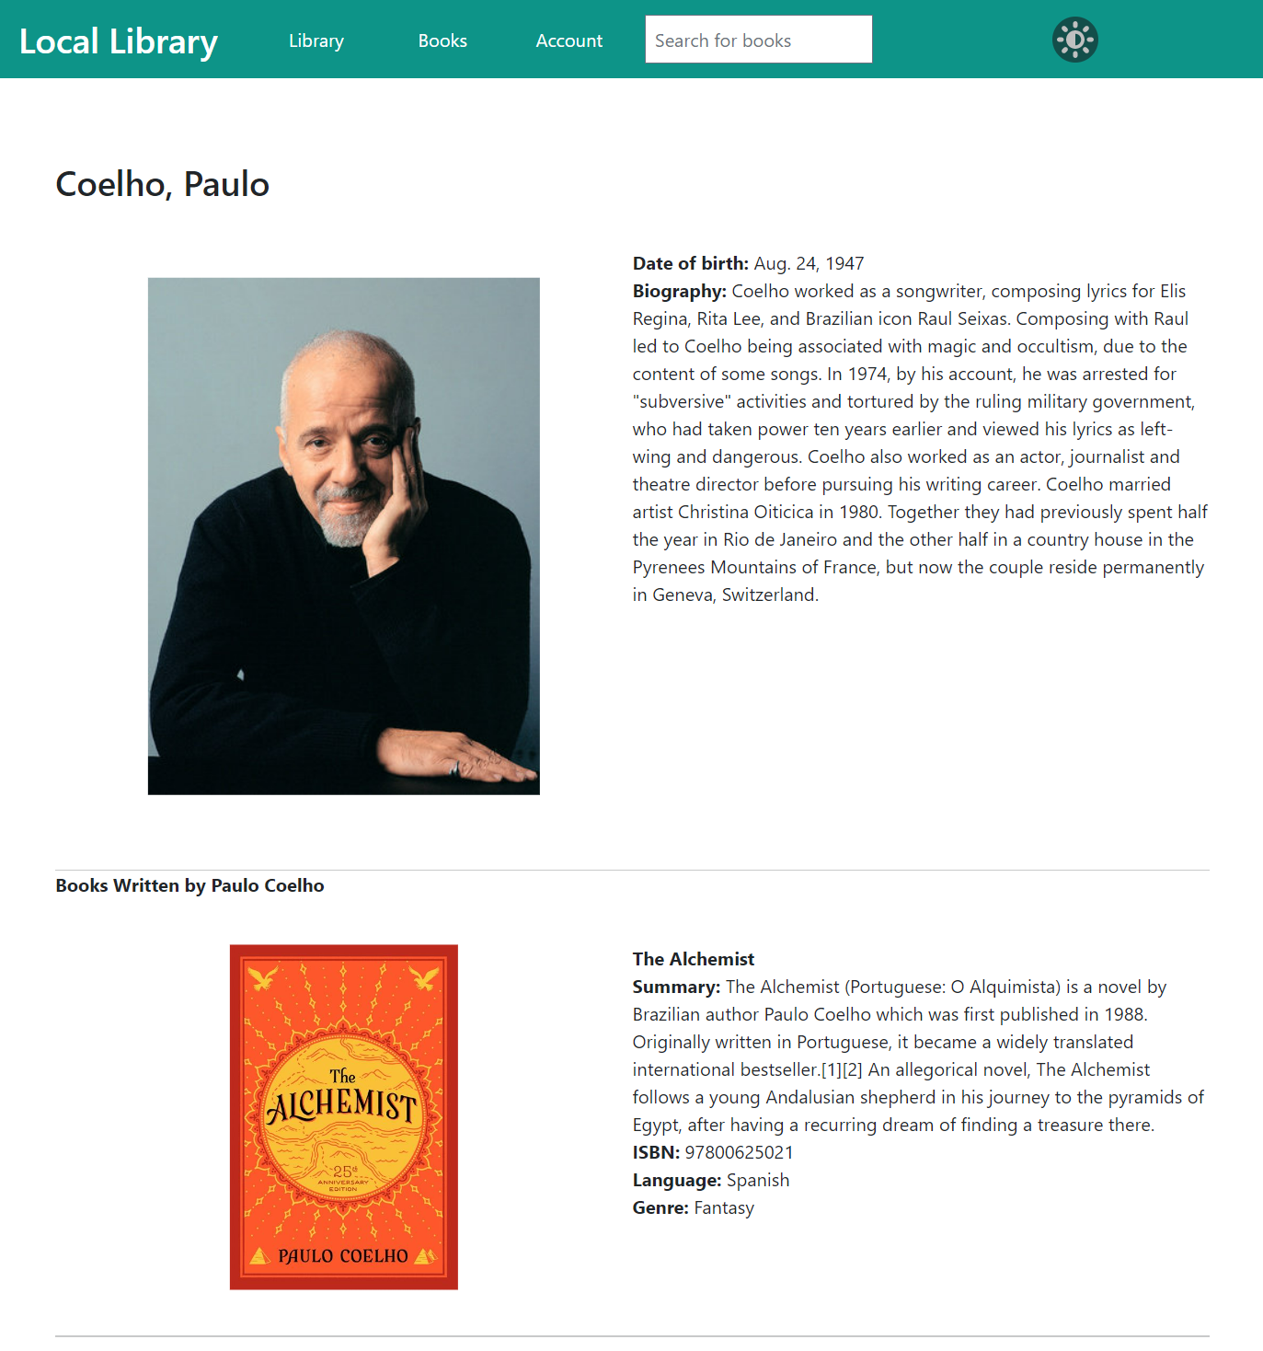

Slide 20
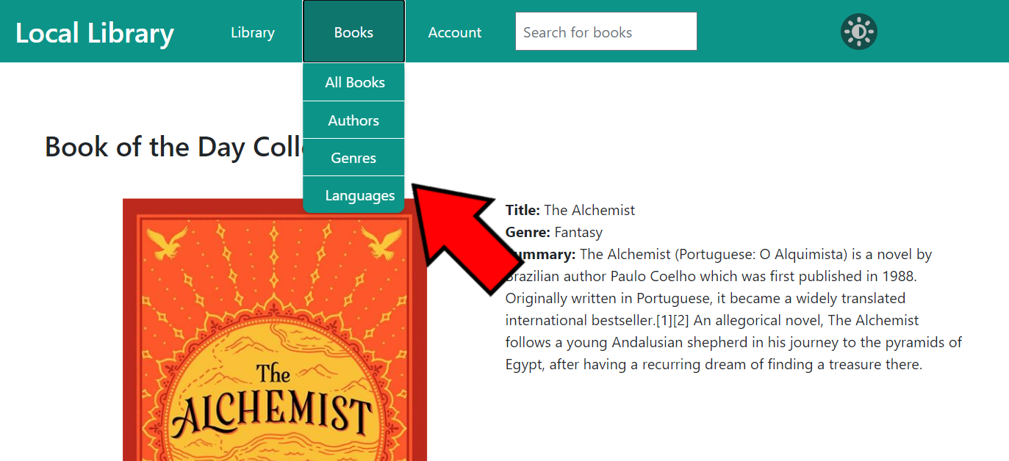
OTHER CATEGORIES
Users can view all the other categories of books in the library catalog (Genre or Language) by clicking the Books button on the navigation bar to view the catalog drop-down menu and clicking on the appropriate category.

Slide 21
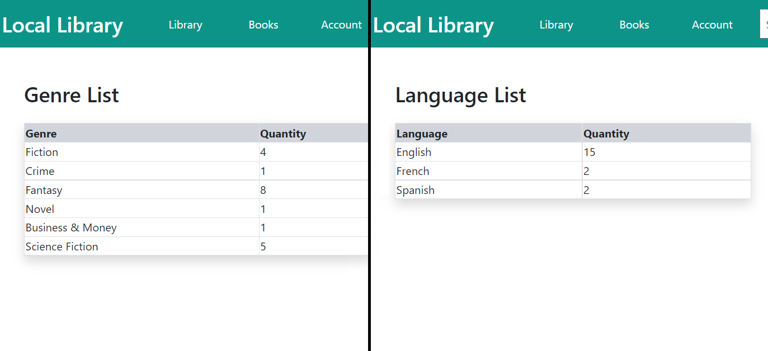
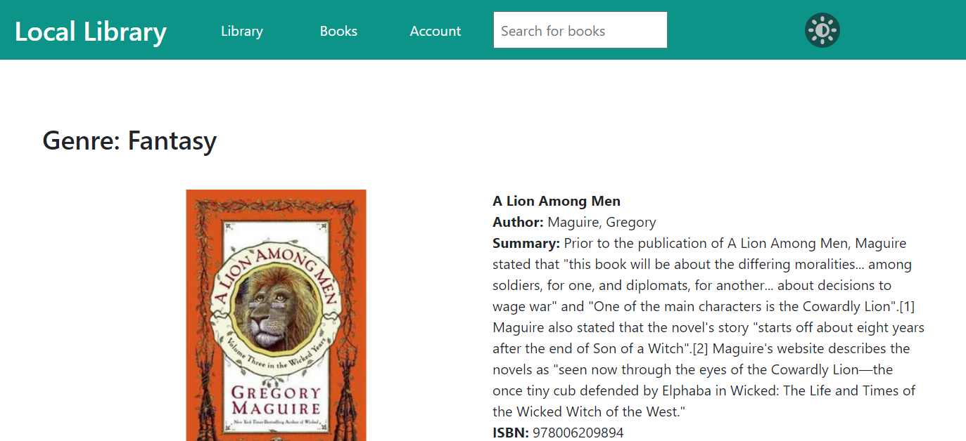

Slide 22
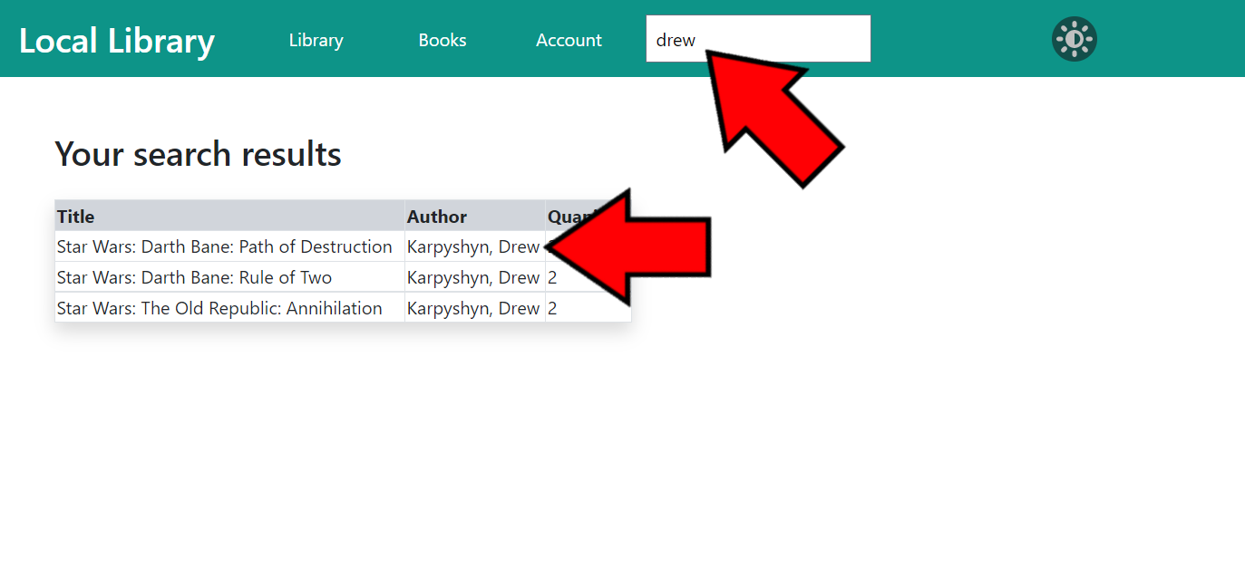
Search Bar
On the navigation bar on each page of the library website is a search bar. The search bar allows users to search for books using keywords and will display a list of books that match those keywords. The keywords are compared to the books’ titles, authors’ names, and languages.

Slide 23
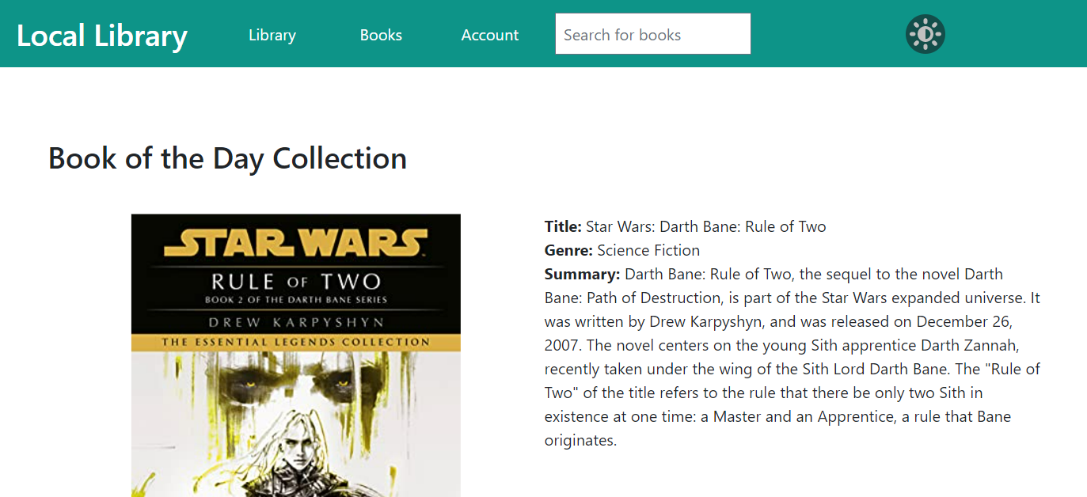
Book of the Day Collection
On the library website’s home page is a Book of the Day Collection. The book in this section changes on each visit and gives users a preview of what kind of books are in the library’s catalog. If you want to view more information about the book of the day, you can click on the title of the book to be brought to the book’s detail page.

Slide 24
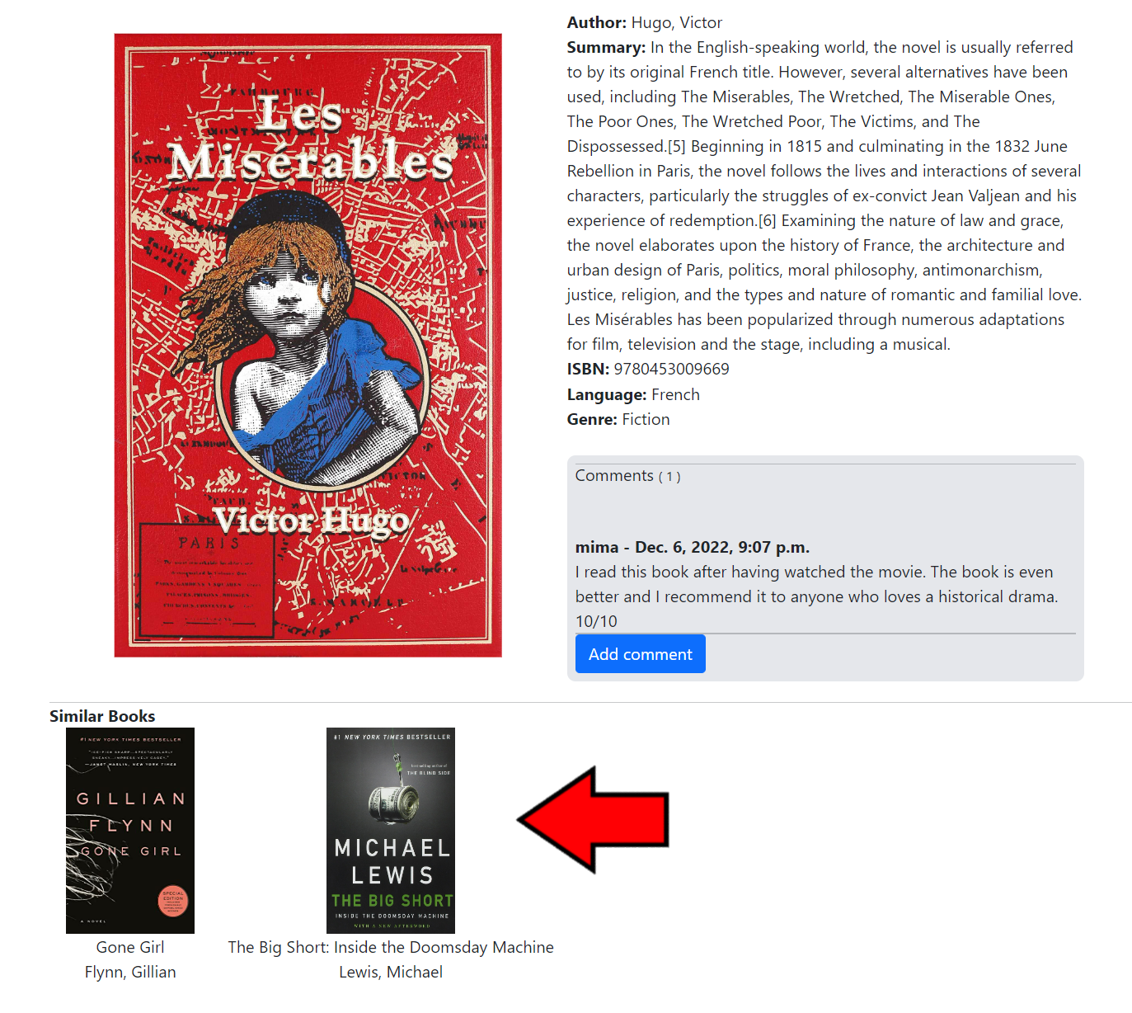
Similar books
On each book detail page in on the library website is a section of similar book recommendations. These books share similar characteristics, such as author, genre, or language.

Slide 25
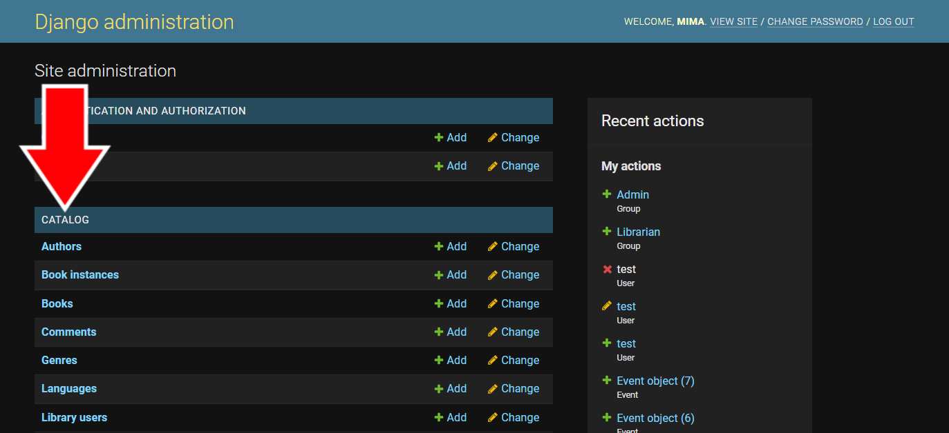
Editing Catalog Content
Information in the library catalog can be changed from the Admin Page. Books, authors, genres, languages, book instances (or copies), and book comments can all be changed from here.

Slide 26
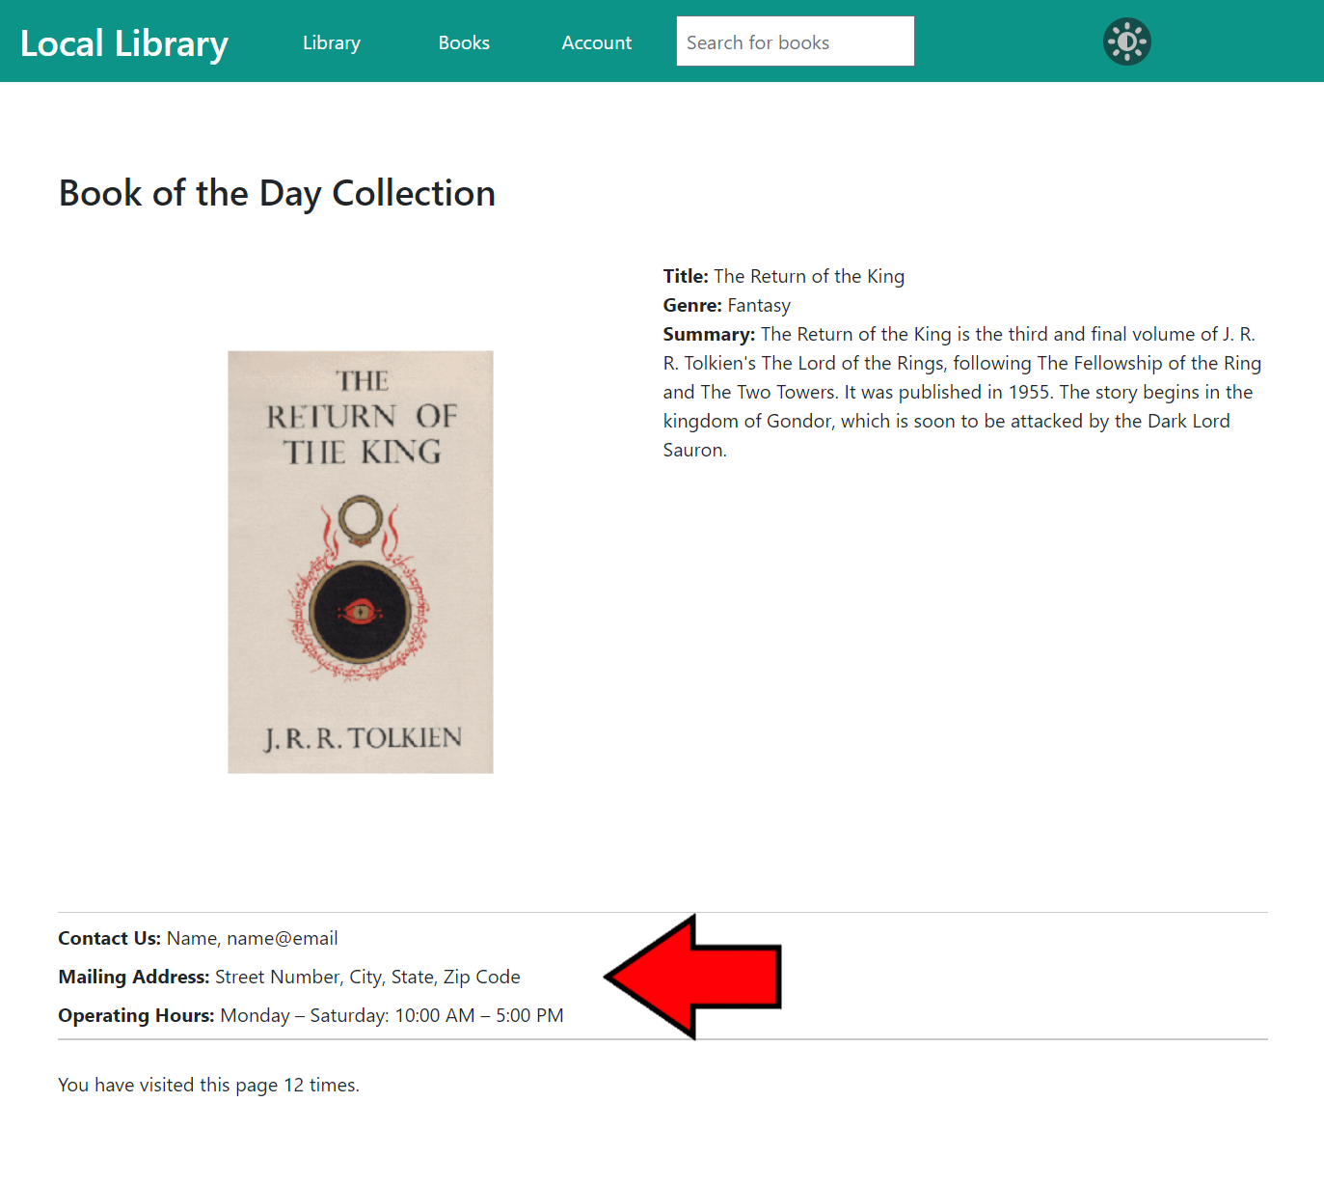
About
Information regarding the physical library can be found on the library website home page, underneath the Book of the Day Collection. This section contains the library’s contact information, hours of operation, and physical address.

Slide 27
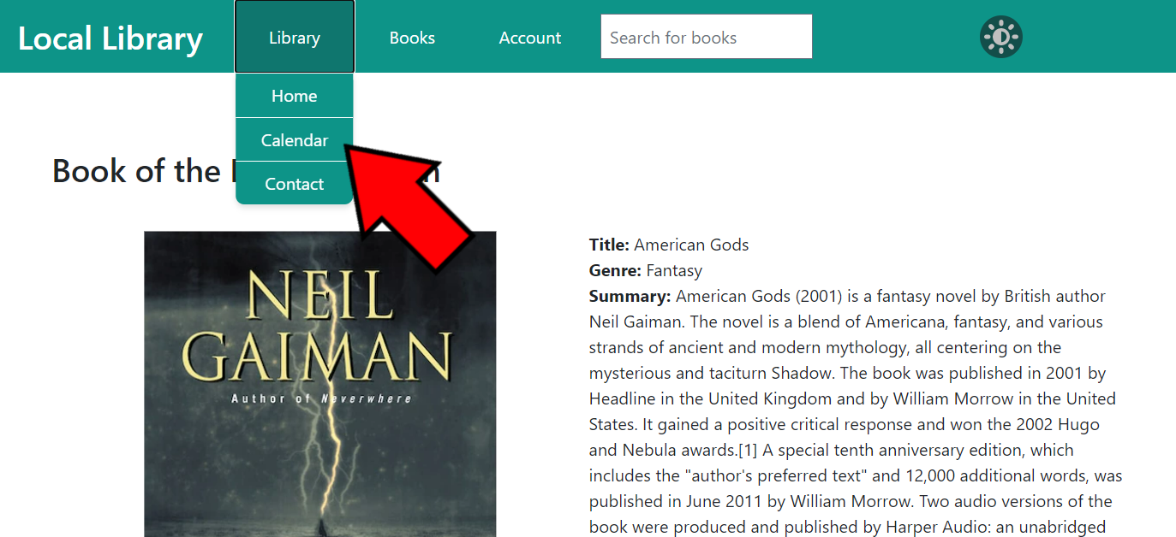
Calendar
The Calendar page can be accessed from any page on the library website via the navigation bar at the top. Click on Library to open the drop-down menu and click on Calendar.

Slide 28
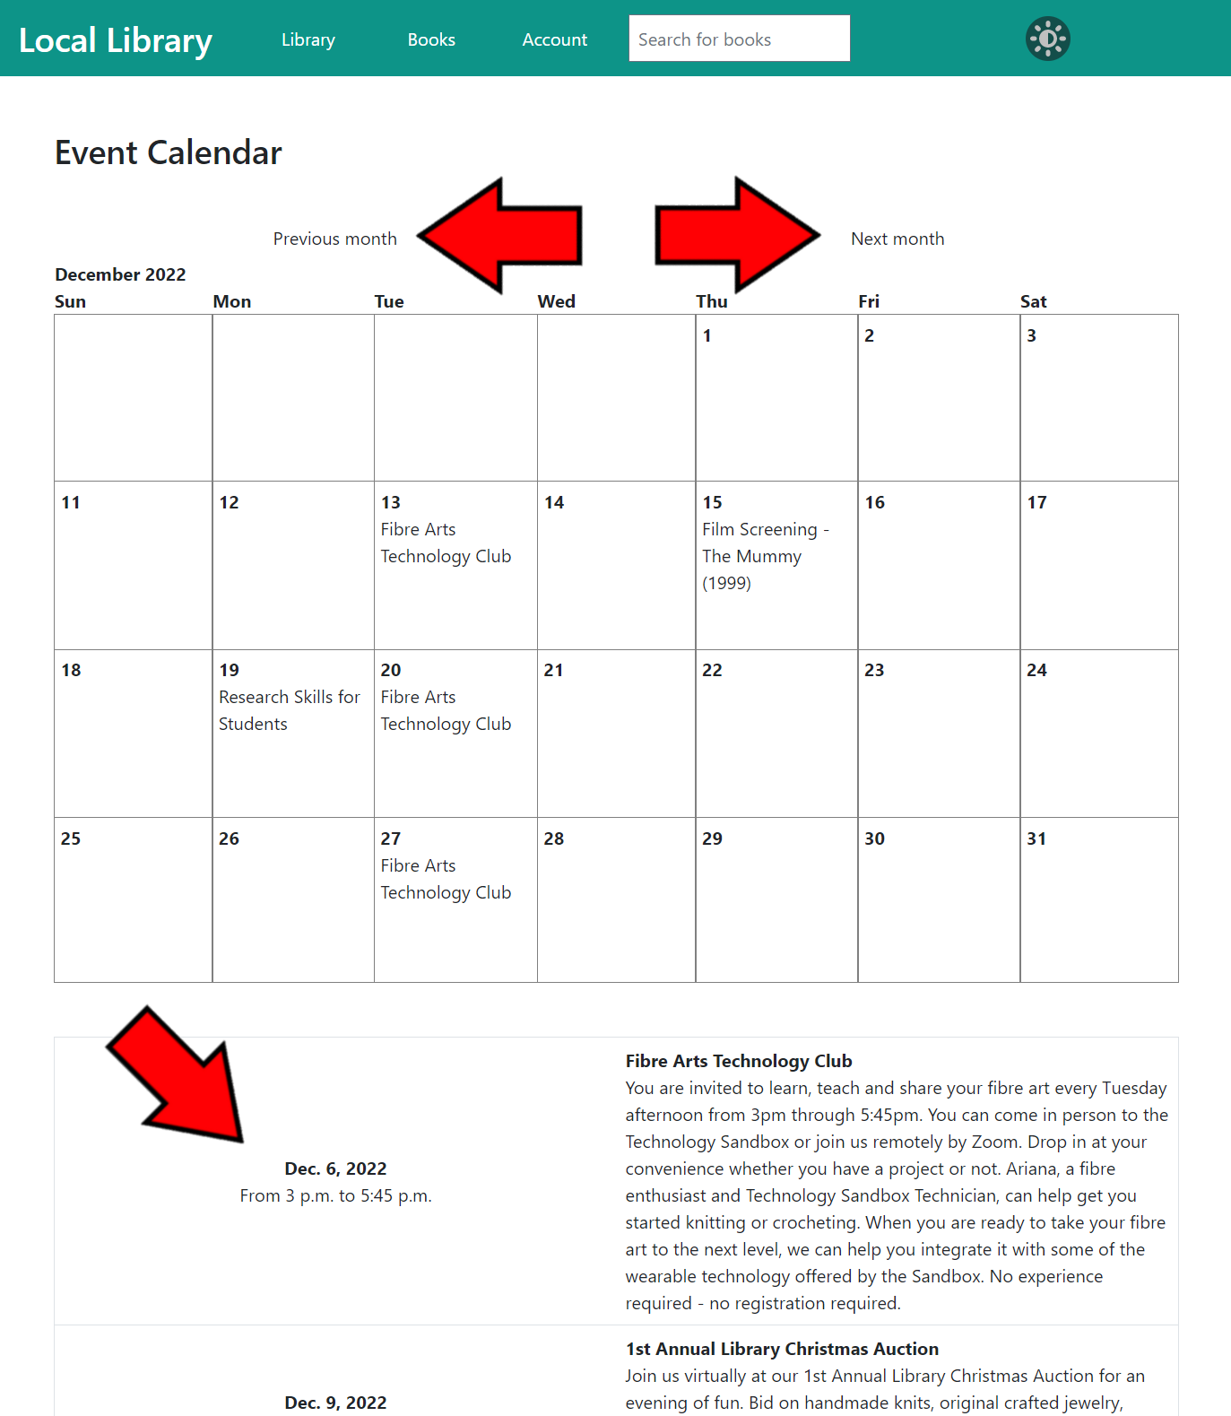

Slide 29
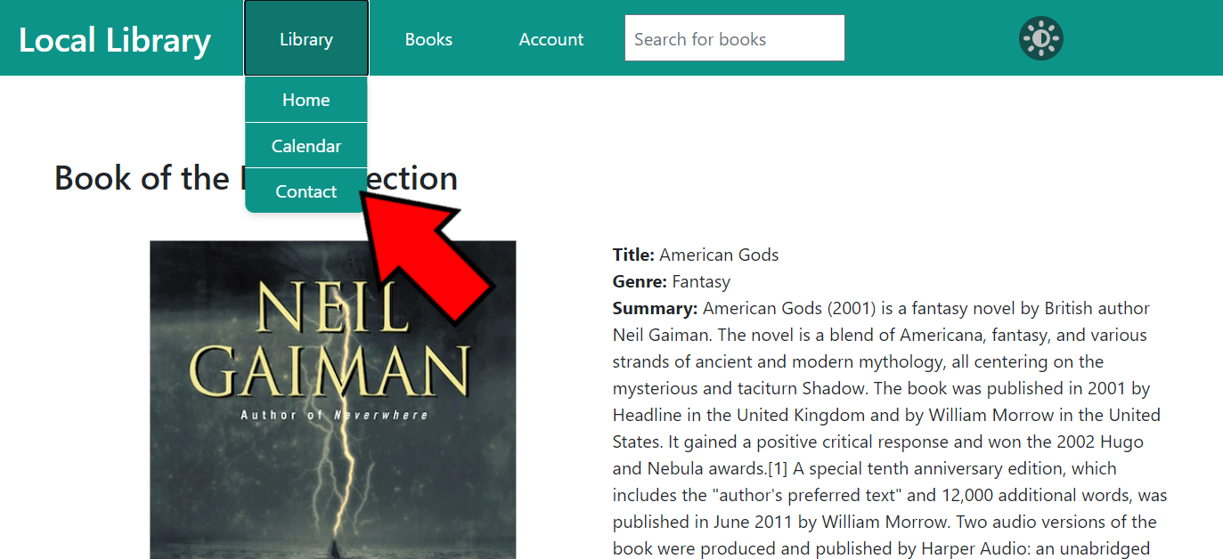
Contact
The library website has a page where users or visitors can contact the library staff with their questions or concerns. The Contact page can be accessed from any page on the library website via the navigation bar at the top. Click on Library to open the drop-down menu and click on Contact.

Slide 30
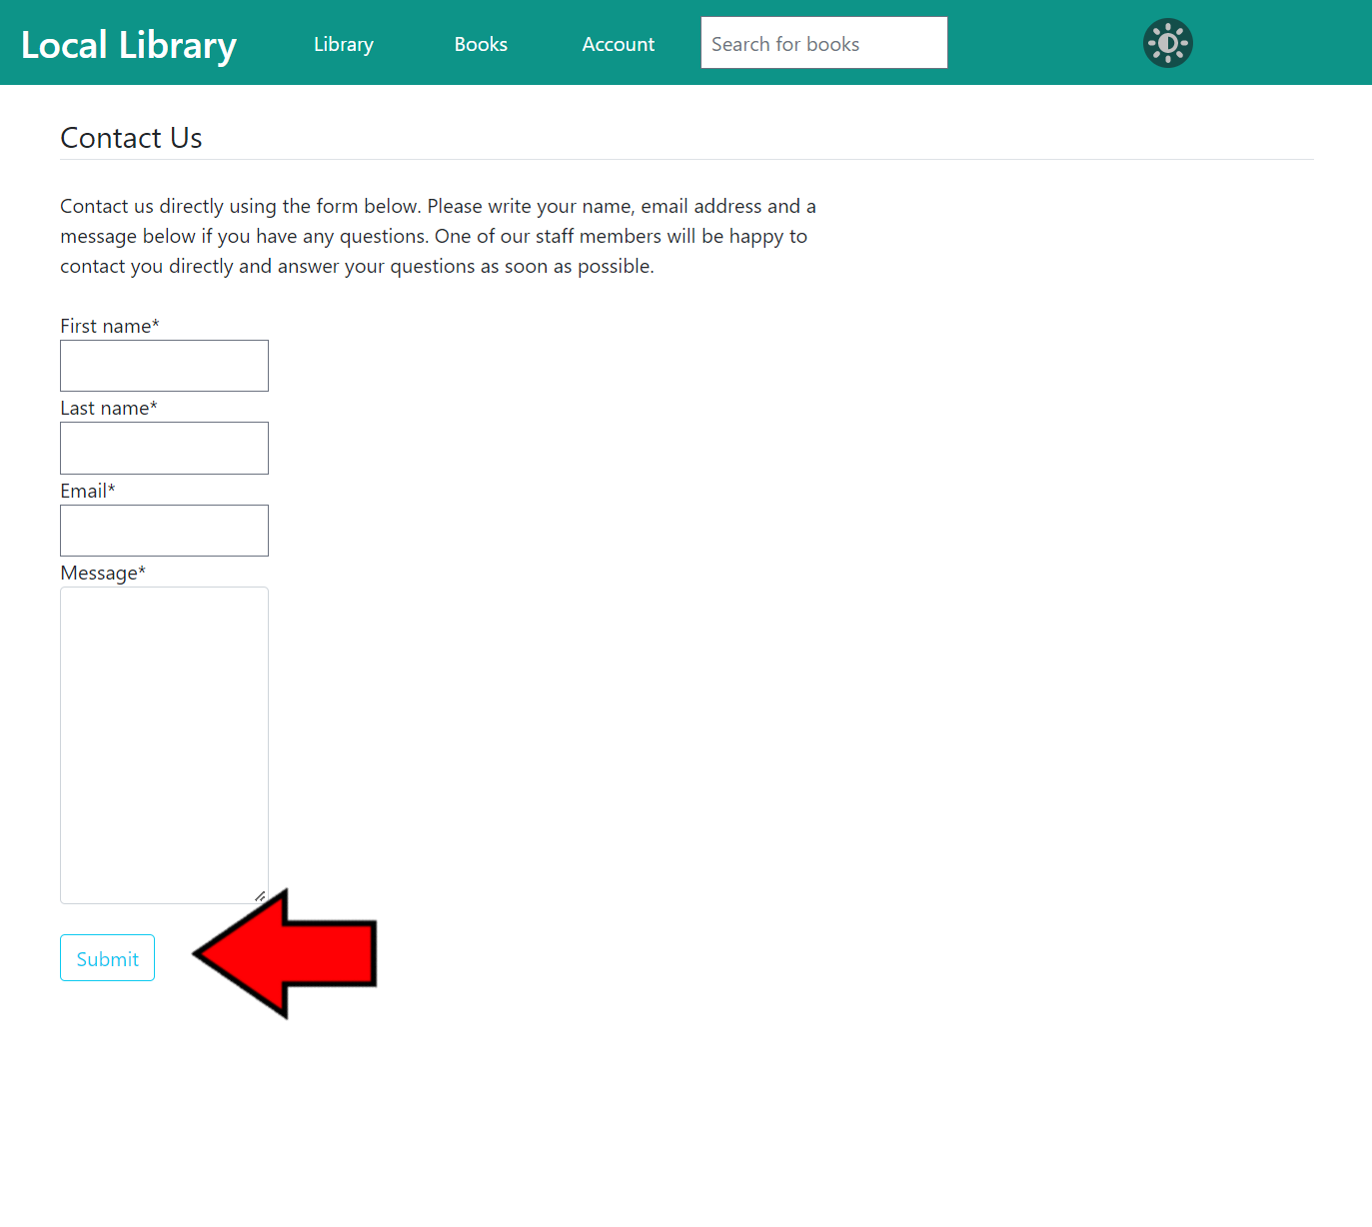

Slide 31
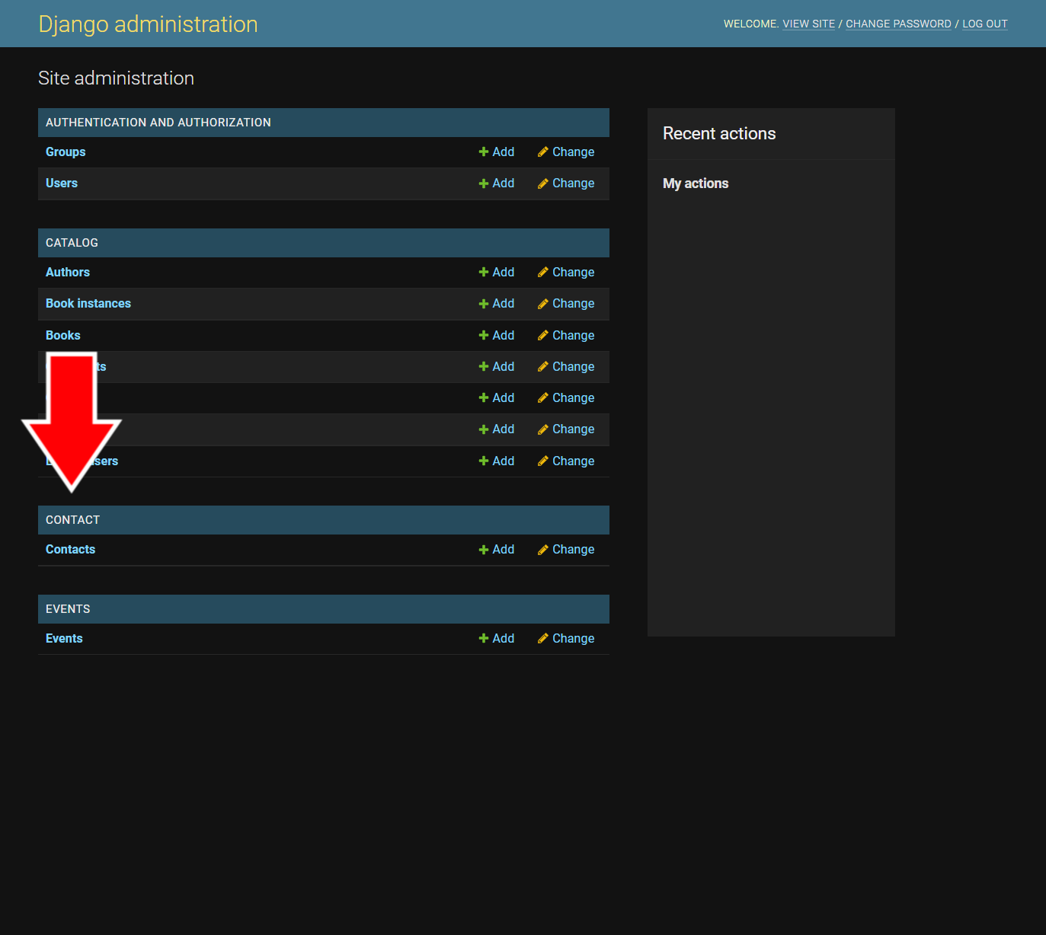
Contact Staff View
Correspondence from the Contact page can be viewed on the Admin Page.

Slide 32
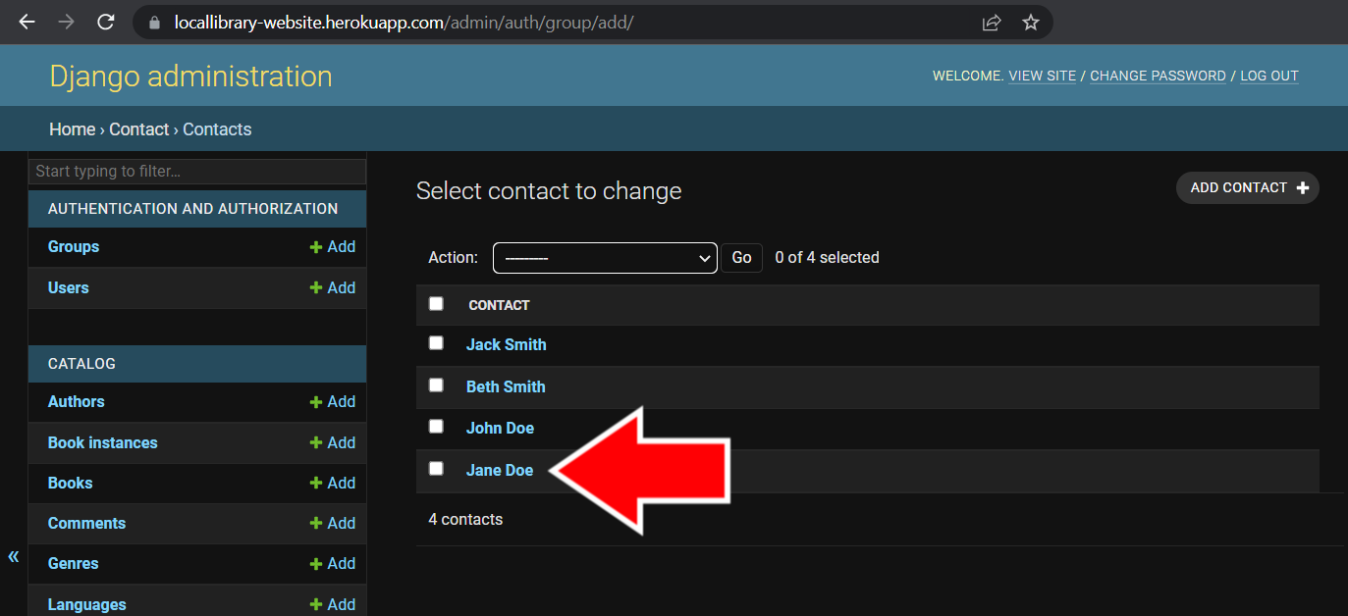
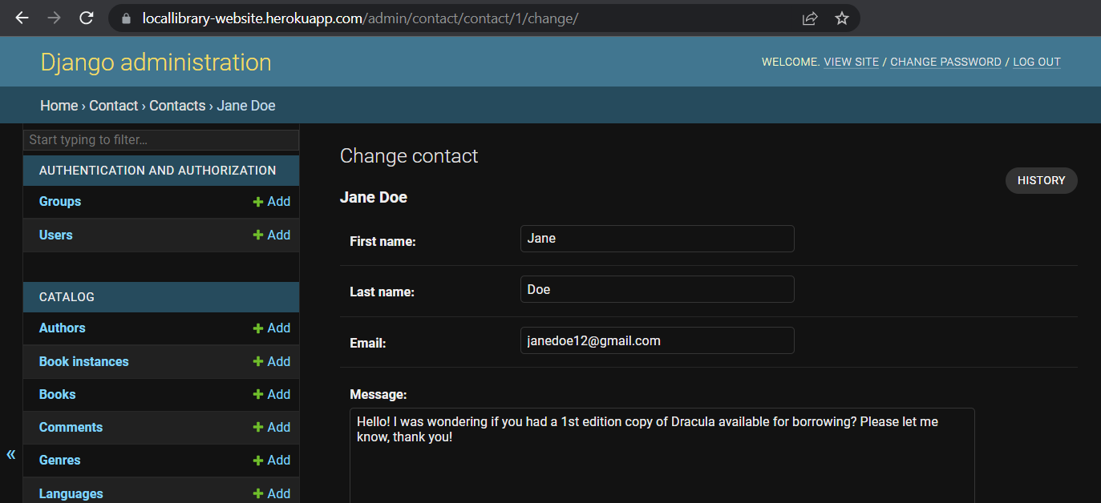

Slide 33
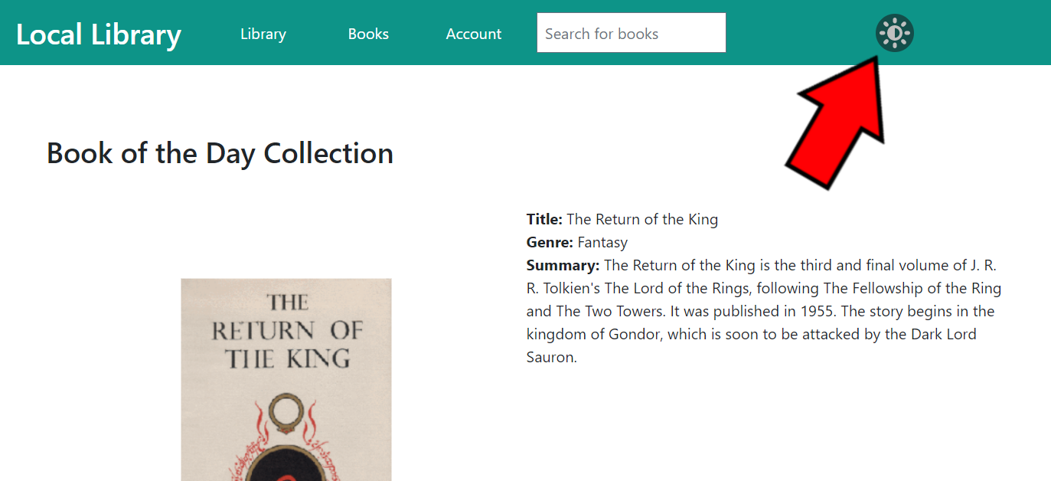
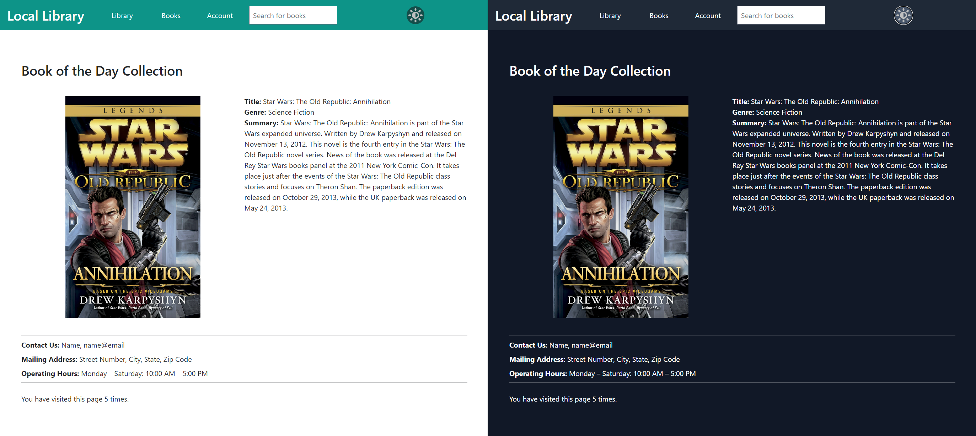
Dark Mode
The library website has the option to be viewed in Dark Mode, which makes the screen less bright to view by changing the colors of the website to dark gray and the text to white.

Slide 34

THANK YOU
TEAM 12
CEN 4010 (RVD)
FALL 2022

